Slide 1
Seattle Public Library analysis & Machine learning
Microsoft Azure Machine learning Studio
&
DATABRICKS

Slide 2
Presented by:- (Group- 1)
SUSHANT BURDE
SWARNIM JAMBHULE
TANVI GAWADE

Slide 3

About the dataset
This is a dataset hosted by the City of Seattle
Integrated Library System (ILS) Data Dictionary: This dataset is useful for understanding the codes used in other corresponding Seattle Public Library datasets. These codes (namely "ItemType" and "ItemCollection") are systematically used in the cataloging of items within Integrated Library System (ILS). The data is used in the daily operation of the library, including circulation, cataloging, acquisitions, collection development, processing, and serials control.
Library Collection Inventory :Consists of all of the physical items in the Seattle Public Library’s collection.
Checkouts by Title :This dataset includes a monthly count of Seattle Public Library checkouts by title for physical and electronic items. The dataset begins with checkouts that occurred in April 2005 and is updated till date.

Slide 4
DATA SET Specifications :
Seattle Public Library Dataset.
Contents of the dataset: Checkouts by Title, Library Collection Inventory, Integrated Library System (ILS) Data Dictionary
Link(https://data.seattle.gov/Community/Library-Collection-Inventory/6vkj-f5xf)
Link (https://data.seattle.gov/Community/Checkouts-by-Title/tmmm-ytt6)

Slide 5
DATA SET Specifications :
Link(https://data.seattle.gov/Community/Integrated-Library-System-ILS-Data-Dictionary/pbt3-ytbc)
Total Size of the data: 7.8 GB

Slide 6
Homework Experimental specifications
Data Bricks Specifications:
Execution: Single Node
Memory: 6GB Capacity
Databricks Runtime Version: 5.2(Incl. Apache Spark 2.4.0, Scala 2.11)
Microsoft Azure Machine Learning Studio Specification:
Execution: Single Node
Storage Space Capacity: 10 GB Memory
Compute Resource Type: ML service is a multitenant service.

Slide 7
MICROSOFT AZURE MACHINE LEARNING STUDIO
MODEL 1: 2 Class Decision Jungle
We have created a model to classify whether the book is floating or not floating(i.e. Circulatory within the Seattle branches or not)
We have used the dataset Library Inventory Dataset for the above classification.
Classification is based on the column Floating Item where Floating Item = Yes and Non Floating Item = No
Data is split into train and test in the ratio of 0.8 0.2
Algorithm used for the above evaluation : 2 Class Decision Jungle

Slide 8
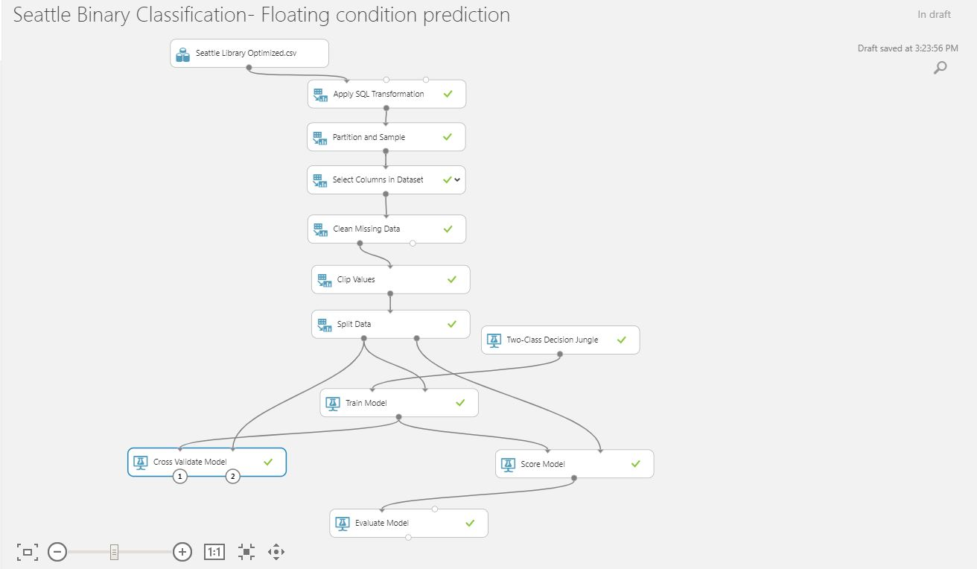
Model 1:

Slide 9

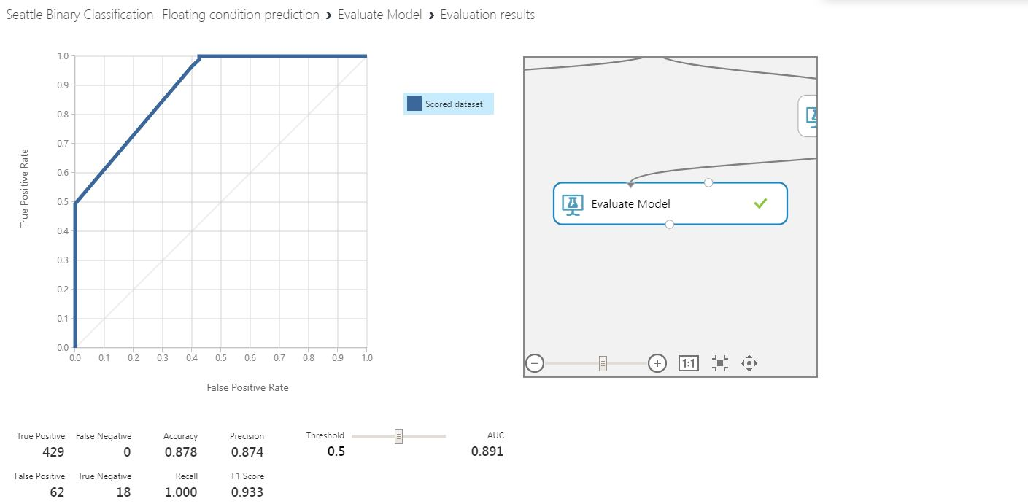
ALGORITHM USED:
2 CLASS DECISION JUNGLE
SPLIT DATA is 80-20 and it is Randomized Split
AUC : 0.891

Slide 10
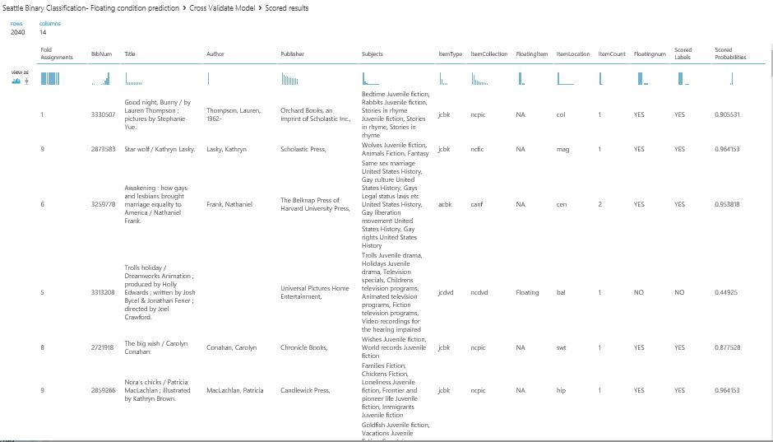
CROSS VALIDATION OUTPUT:

Slide 11
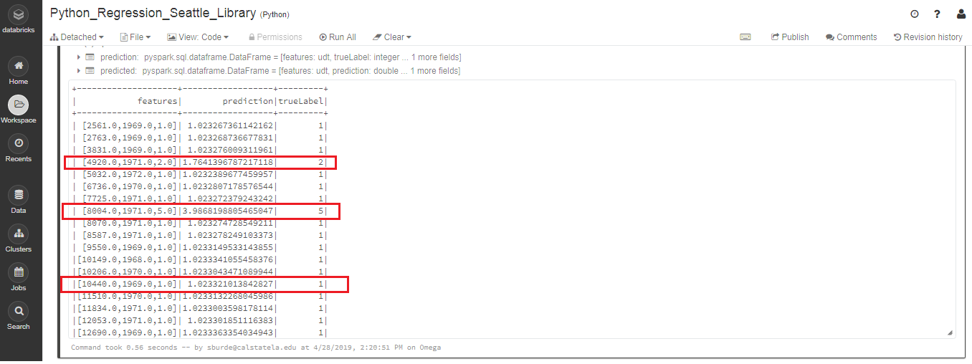
DATA Bricks (SPARK Machine Learning)
MODEL 1:
ALGORITHM USED : LINEAR REGRESSION
OUTPUT: Predicted column contains the predicted value for the label, TrueLabel column contains the actual known value from the testing data.

Slide 12
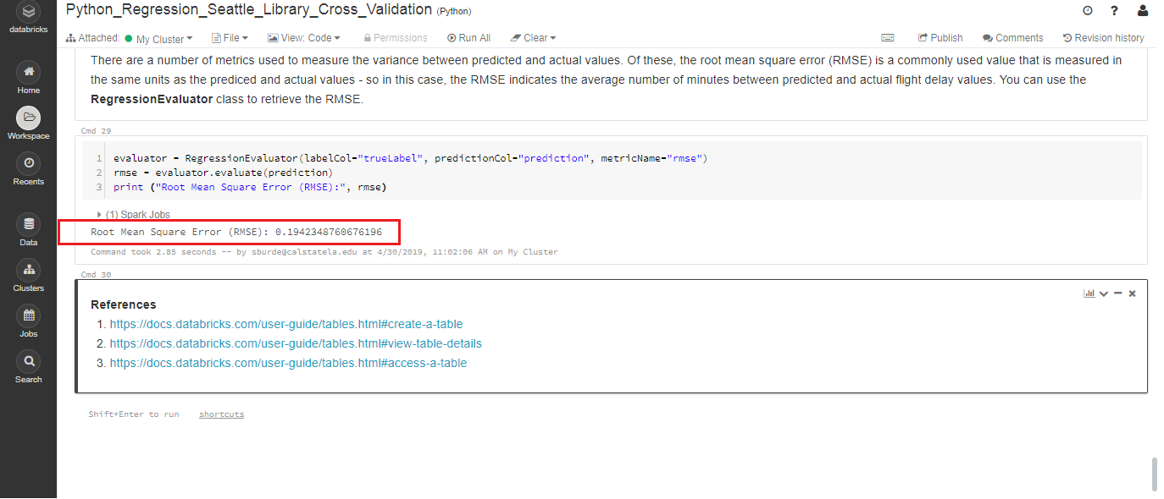
MODEL 1:
RMSE : 0.19423

Slide 13
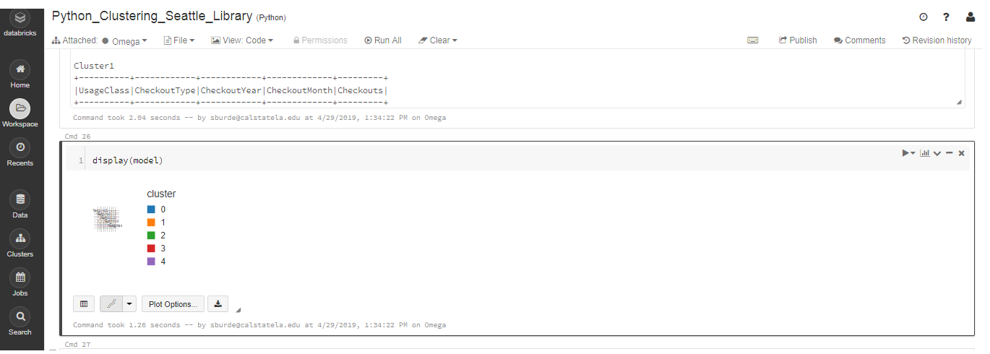
DATA Bricks (SPARK Machine Learning)
MODEL 2:
ALGORITHM USED : CLUSTERING
OUTPUT: Clustering is based on Major distributer sources like Horizon, Overdrive, Freegal, Hoopla and Zinio.

Slide 14
References:
https://docs.microsoft.com/en-us/azure/machine-learning/studio/create-experiment
https://forums.databricks.com/
https://stackoverflow.com/questions/tagged/databricks
https://docs.microsoft.com/en-us/azure/machine-learning/studio/faq

Slide 15
Microsoft Azure Machine Learning
https://gallery.azure.ai/Experiment/Seattle-Binary-Classification-Floating-condition-prediction

Slide 16
Thank you!!!

